Slide 1

Ai based attention estimation using deep neural networks
K. Arbaz ( 1602-17-737-061) Internal Guide: Mrs. S. Aruna
B. V. Anand ( 1602-17-737-114) External Guide: Dr. K. Raghavendra

Slide 2
Outline of presentation
Introduction
Problem statement
Literature review and existing system
Proposed system and model
Hardware and software specifications
Dataset
Emotion recognition and gaze tracking
Demo
Conclusion and references

Slide 3
Introduction
Attention is the behavioral and cognitive process of selectively concentrating on a discrete aspect of information, whether considered subjective or objective, while ignoring other perceivable information.
Variations in eye movements, duration of fixations, patterns and frequency of blinks are all relevant to how a person is responding to a visual stimulus like a video, a website.
Our Idea is to combine eye-tracking plus facial expressions, which can be used to measure emotional valence in conjunction with gaze during exposure to stimuli.
(For students attending lectures via video conferencing applications).

Slide 4
Emotions
Emotions are an inherent part, of an individual which gives us a glance at the cognitive state of mind.
Various form of research, has been done in the field earliest being the feedback mechanism to identify the emotion of a person.
Emotion’s recognition can be implemented using various features like face, speech, text, etc
Emotion recognition has various applications in the field of website Design, gaming, analysis etc.

Slide 5
Gaze
Most dedicated eye-tracking systems use infrared (IR) light to find and trace eye movements and other important measures such as pupil size and distance for the stimulus source
Webcam-based systems are different in that they can only access the visible light captured by the webcam.
Webcam-based eye-tracking is still less precise than dedicated IR systems

Slide 6
problem statement
In the pandemic situation such as now, people have shifted from classroom learning to online learning.
We want to provide a good solution to this problem using emotion recognition and gaze tracking, in order to calculate the ‘attentiveness’ of the student.
This problem’s solution can be applied to online markets to analyze the attention of customers to UI.

Slide 7
Literature review
There have been various works in the field of emotion recognition.
The prominent ones which were used to determine the emotion would be the use of biological signals and facial data.
The biological signals such as heart rate, breathing rate, blood pressure would be used to identify what the person is feeling.
Upani Wijeratne later came on to use brain waves to get the frequency being produced and the region of the brain getting activated to check the emotional state of an individual with the help of Electroencephalography.
Deep Learning-Based Emotion-Sensitive Learning Cognitive State Analysis.

Slide 8
Existing V proposed system
Existing
expression detection + landmark location + Head Pose estimation.
How ever head pose estimation is prone to error.
Proposed
The proposed system uses emotion recognition and gaze tracking to decide whether the use is looking at the screen or not.
By tracking their eyes we are able to tell where they are looking probably. Ex: a person can face the screen and still look in any other direction.

Slide 9
Proposed work
In the proposed framework we try to implement the convolutional neural network (CNN) along with the eye-tracking system which will be able to identify the student's attentiveness in a lecture.
The model for emotion detection is made with the CNN based on VGG – 16 model.( Visual Geometry group )
The will be trained on a model built which uses dataset with its images being classified into seven different emotions as a base for emotion recognition.

Slide 10
Proposed model
.
FER DATASET
IMAGE PROCESSING
CNN MODEL FOR EMOTION RECOGNITION
ATTENTION DETECTION MODEL
OUTPUT
Live Feed
+
Face landmark detector
Eye tracking system

Slide 11
Working model
The model is to combine the emotion recognition and the eye tracking system in order to determine the attentivity of student in the class.
The model has been divided into two parts:
Emotion recognition
Eye tracking system.
The model has been made on Jupyter notebook

Slide 12
Software and hardware
Python
Keras
TensorFlow
OpenCV
Dlib
Cmake
Windows 10-64bit
These are the specifications of the machine on which this project was developed.
The application is capable of executing on any windows 10 machine with at least 4Gb of RAM
CPU: Intel(R) Core(TM) i5-8300H CPU @ 2.30GHz
Memory: 8GB DDR4
Laptop Default Webcam

Slide 13
dataset
The dataset used for the project is the FER dataset which contains around 35000 images of size 48 x 48 pixels divided among seven classes which are happy, sad, neutral, angry, surprise, disgust, and fear.
The faces have been automatically registered so that the face is more or less centered and occupies about the same amount of space in each image.
The training set consists of 28,911 samples and the public test set consists of 7,066 samples.
The percentage of train – test split is training sample – 80% and testing sample – 20%.

Slide 14









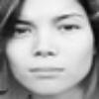
Images from The FER Dataset

Slide 15

Emotion recognition
The emotion recognition model is made by taking the images from the FER dataset and using it under the CNN model.
The model takes the images and converts it into a 2D matrix of numbers to find the pattern in the images.
It uses the activation function like relu (rectified linear activation function) ,elu (Exponential Linear Unit) etc at the end of or in between Neural Networks.

Slide 16
Emotion recognition
VGG16 (also called OxfordNet) is a convolutional neural network architecture named after the Visual Geometry Group from Oxford, who developed it.
VGG16 is that instead of having a large number of hyper-parameters they focused on having convolution layers of 3x3 filter with a stride 1 and always used same padding and MaxPooling layer of 2x2 filter of stride 2.
It follows this arrangement of convolution and max pool layers consistently throughout the whole architecture.
In the end it has 2 FC (fully connected layers) followed by a Softmax for output.

Slide 17
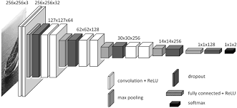
CNN MODEL

Slide 18
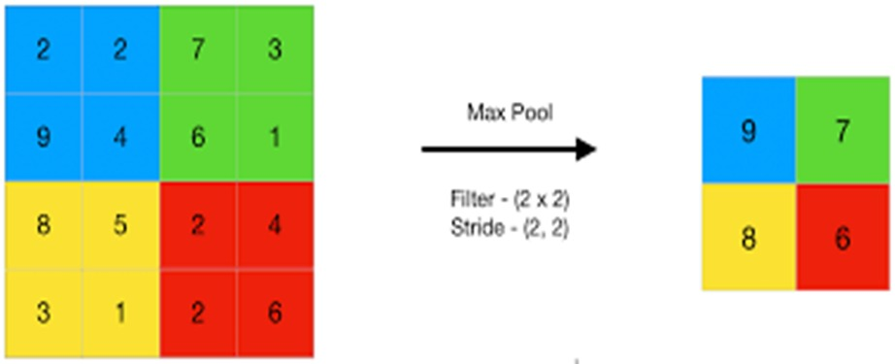

Slide 19
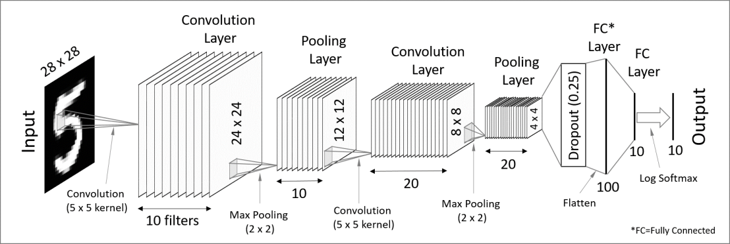
Pattern recognition

Slide 20
Emotion recognition
The first part is the taking of input and making it work in the model in the field of feature extraction.
It takes the input in the form of images that have been modified, but before that happens we use an image generator to produce more images in different forms, now these images would be similar to the original images with differences such as resizing, space shifting, rotating, etc
Conv2D layer has a height and a width. They are generally smaller than the input image and so we move them across the whole image.
The later stages would then follow the use of activation function, an activation function is at the end deciding what is to be fired to the next neuron.
Notes:
.

Slide 21
Emotion recognition
This is used along with Batch Normalization where Batch normalization is a technique for training very deep neural networks that standardizes the inputs to a layer for each mini-batch.
It stabilizes the learning process and dramatically reducing the number of training epochs required to train deep networks.
The end of this layer would be to use a MaxPooling function which would summarize the average presence of a feature.
The next layers focuses on flattening the obtained inputs from the above layers , Flattening is converting the data into a 1-dimensional array for inputting it to the next layer.

Slide 22
Emotion recognition
We flatten the output of the convolutional layers to create a single long feature vector. And it is connected to the final classification model, which is called a fully connected layer.
In the later part of the code after making the model , just before compiling the model we use optimizers like:
ModelCheckpoint
EarlyStopping
ReduceLROnPlateau.

Slide 23
Emotion recognition
ModelCheckpoint saves the model which has better accuracy
Early stopping is a method that allows you to specify an arbitrary large number of training epochs and stop training once the model performance stops improving on a hold out validation dataset.
Reduce (LR) learning rate when a metric has stopped improving. Models often benefit from reducing the learning rate by a factor of 2-10 once learning stagnates
The proposed work has been able to attain an accuracy of around 94%.

Slide 24
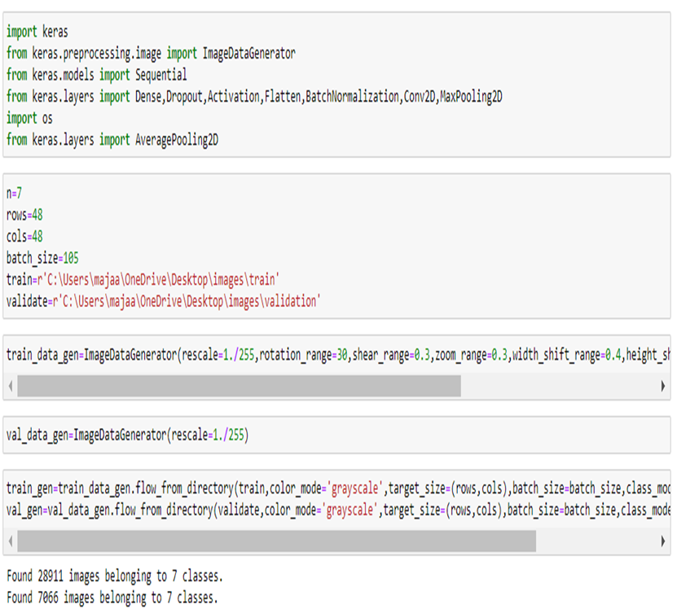
Emotion RECOGNITION

Slide 25
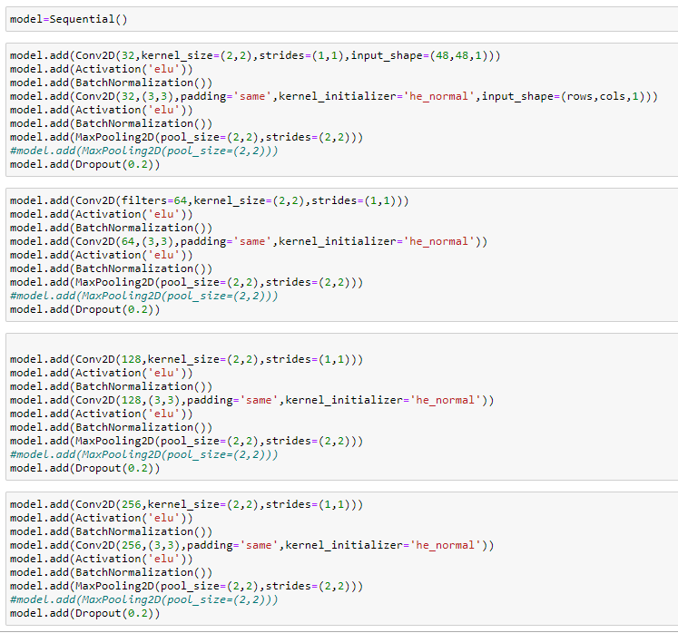
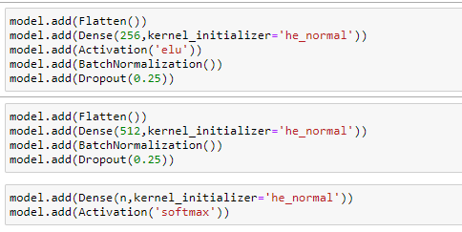
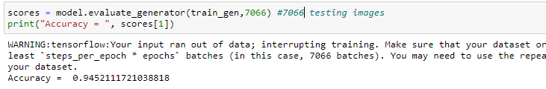
Emotion RECOGNITION

Slide 26
Gaze TRACKING
The later part of the model focuses on the eye-tracking system would be to track the eye movement of the student to determine the attentiveness of the student.
There are 4 classes which are used in the gaze tracking system:
Calibrate
Eye
Pupil
Gaze tracking

Slide 27
Gaze tracking
The eye-tracking system is used to track the eye movement of the student to determine the attentiveness of the student.
This is achieved with the help of the face landmarks detection approach we can find 68 specific landmarks of the face.
We need to detect the two eyes independently:
Left eye points: (36, 37, 38, 39, 40, 41)
Right eye points: (42, 43, 44, 45, 46, 47)

Slide 28
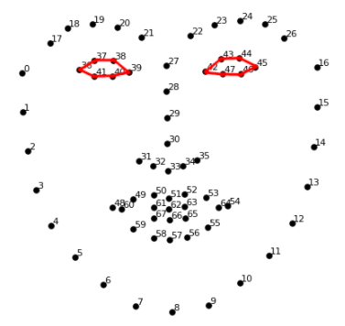
Gaze tracking

Slide 29
GAZE tracking
The line detection allows us to create the borders around the eye and the iris.
Taking the iris we can calculate the centroid of the iris to calculate the position of the centre of the iris to estimate where the person is looking.
The person can be identified to be looking at any location by taking the ratio sum of left and right pupil divided by 2 .

Slide 30
gaze tracking
Eye(for isolating the eye).
The function isolate is used to isolate the eyes from the face.
The function _blinking_ returns whether the user is blinking or not
The function analyse Detects and isolates the eye in a new frame, sends data to the calibration and initializes Pupil object.
Calibration (for marking the position of the eye)
It has find_best_threshold which calculates the optimal threshold to binarize the frame for the given eye.
The function evaluate Improves calibration by taking into consideration the given image.

Slide 31
gaze tracking
GazeTracking(for tracking the gaze of person)
The function _analyze is used to detect the face and initialize Eye objects.
The function horizontal_ratio and vertical_ratio is used to know the horizontal position and vertical position of the pupil.
The function annotated_frame is used to highlight the pupils location.
Pupil(for detecting the iris)
The function imageprocessing performs operations on the eye frame to isolate the iris.
The function detect_iris detects the iris and estimates the position of the iris by calculating the centroid.

Slide 32
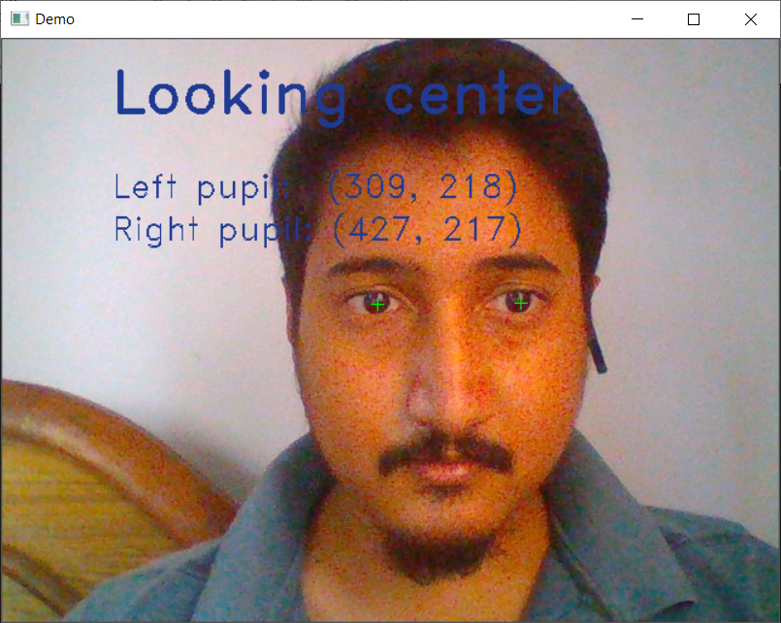
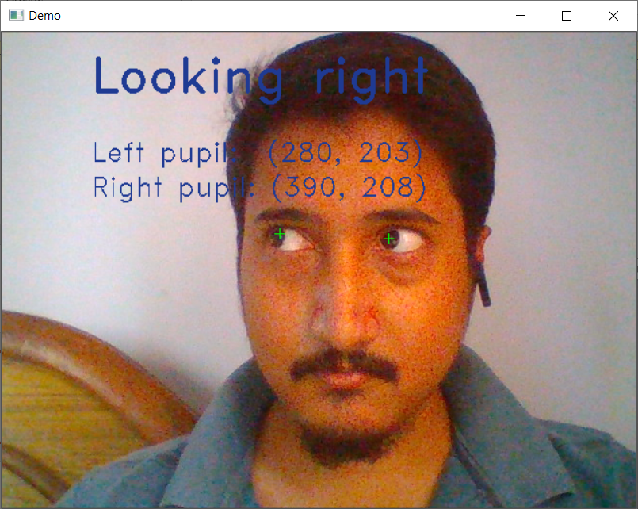
Eye tracker

Slide 33
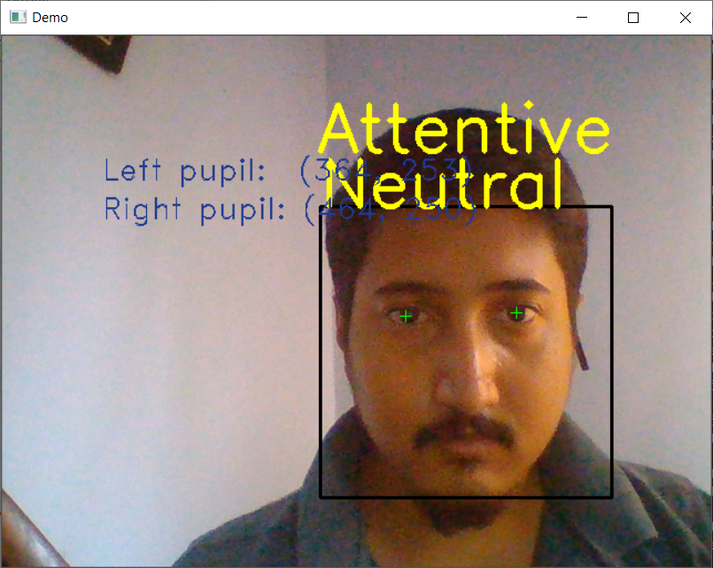
Attention estimation system

Slide 34
Improvements on the existing implementation
Did transfer learning on the model using our faces to increase accuracy on native faces.
Worked on the tolerances of Gaze Tracking to be more precise
Read a book on teaching
Discovered a circumplex of emotions which report engagement of a student
Prepared our own circumplex to suite our set of emotions for we trained our model for
Devised a formula to infer from the circumplex to rate engagement

Slide 35
How to generate result
Data sampling
Take 2 frames per second. //after discussion we concluded that 2 frames per is a good rate to capture data
Consolidation
Processed chunks of 30seconds of data( 60frames ) concluded for those set of frames.
Final Report
Merging results from the circumplex and set out a report of attentive Boolean for frames and the amount of engagement with respect to the circumplex

Slide 36
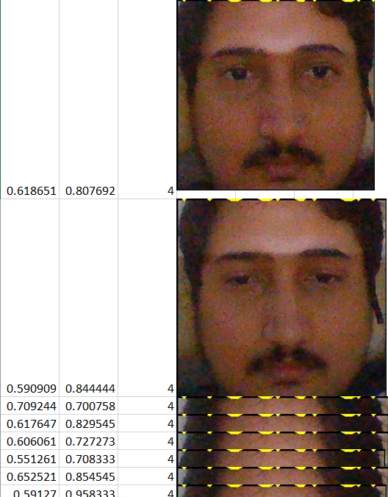
Data sampling
Here we are collecting data every 0.499 seconds
First column : HR: horizontal ratio
Seconds Column : VR: Vertical ratio
Third Column: Emotion Number.
Fourth Colum: the face cutout
This data is stored in a data.xlsx file, which will be later read
by a report_generator module, which will conclude
form the data.
It is taking roughly 1ms to process a frame, hence we are
Waiting for .499 to take 2 fps.

Slide 37
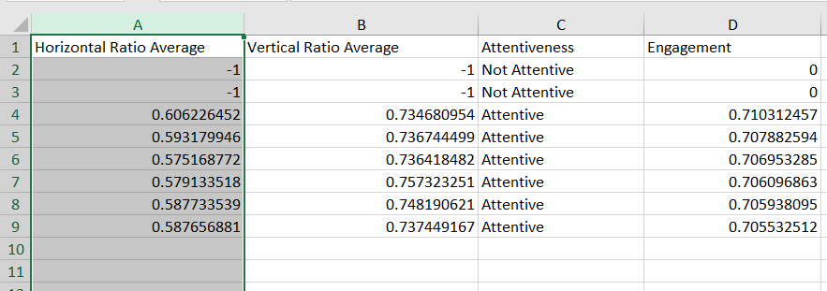
consolidation
We are grouping and merging results for 30second frames (each row is 30seconds)
A “-1” indicates that for the specific row, the user was out of bounds and straight inattentive.
The first and second columns are HR,VR values averaged over 30 seconds.
The next two columns are their meanings, if they are inside the tolerance then it is considered attentive
The last column is the emotional Engaged, which is based on the Circumplex model.

Slide 38
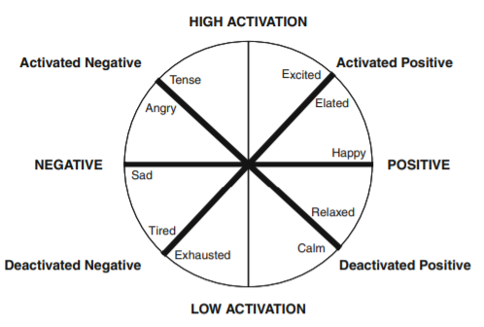
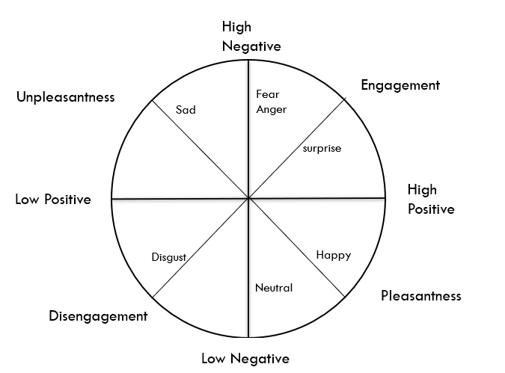
Circumplex
X=( 360 - ( x ± 24 ) ) / 180 :
This equation is used to calculate the angle which give us the engagement inside the circumplex

Slide 39
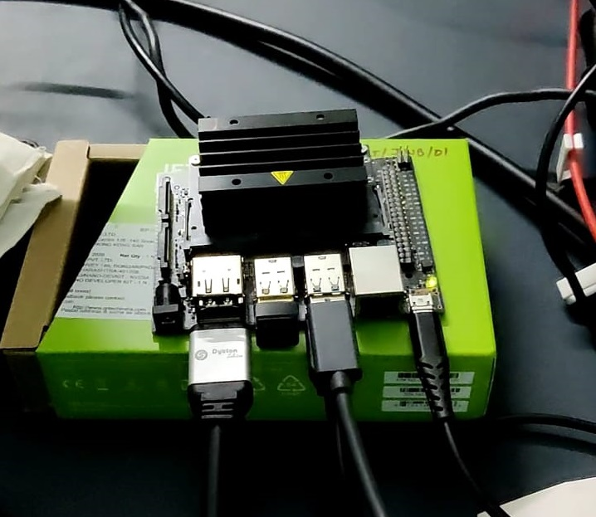
Nvidia jetson nano
CPU- ARM Cortex A57 4-core 1.43GHz
GPU- Maxwell GPU , 128 core 921MHz
RAM- 4Gb LPDDR4 1600MHz
Disk – 32 GB micro SD card

Slide 40
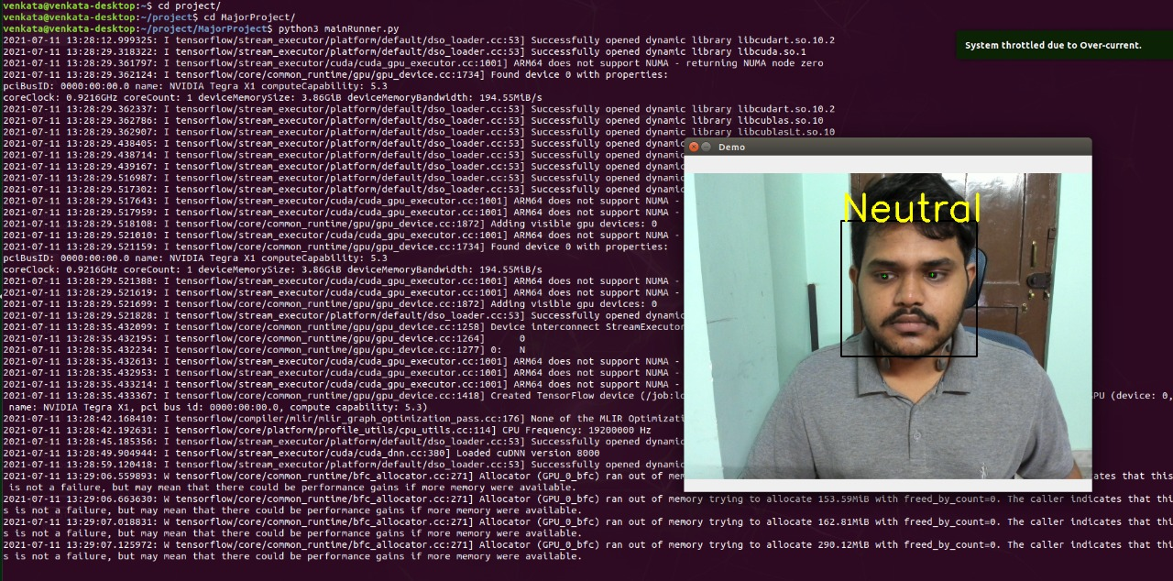
Deployment on Nvidia jetson nano

Slide 41
references
Towards emotion-sensitive learning cognitive state analysis of big data in education: deep learning-based facial expression analysis using ordinal information Ruyi Xu1,2 · Jingying Chen1,2 · Jiaxu Han1,2 · Lei Tan1,2 · Luhui Xu1,2 Received: 28 September 2018 / Accepted: 22 April 2019 © Springer-Verlag GmbH Austria, part of Springer Nature 2019

Slide 42
Thank you
.

